Slide 1

Chapter 3: Solving Problems by Searching

Slide 2
Problem Solving Agent
Problem-solving agent: a type of goal-based agent
Decide what to do by finding sequences of actions that lead to desirable states
Goal formulation: based on current situation and agent’s performance measure
Problem formulation: deciding what actions and states to consider, given a goal
The process of looking for such a sequence of actions is called search

Slide 3
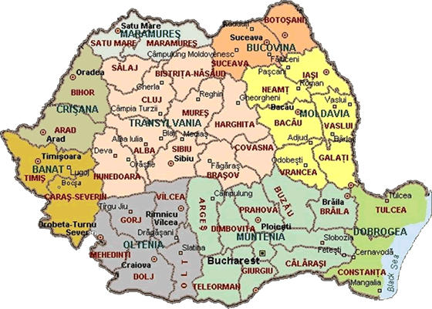

Slide 4
Example: Romania Touring
On holiday in Romania; currently in Arad
Non-refundable ticket to fly out of Bucharest tomorrow
Formulate goal (perf. evaluation):
be in Bucharest before the flight
Formulate problem:
states: various cities
actions: drive between cities
Search:
sequence of cities

Slide 5
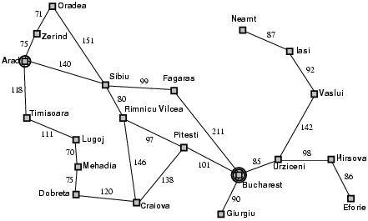
Road Map of Romania

Slide 6
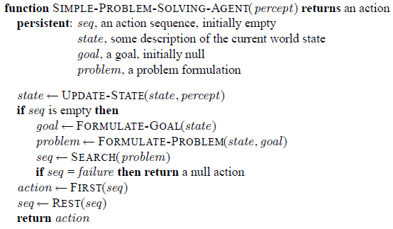
Problem-Solving Agents

Slide 7
Aspects of the Simple Problem Solver
Where does it fit into the agents and environments discussion?
Static environment
Observable
Discrete
Deterministic
Open-loop system: percepts are ignored, thus break the loop between agent and environment

Slide 8
Well-Defined Problems
A problem can be defined formally by five components:
Initial state
Actions
Transition model: description of what each action does (successor)
Goal test
Path cost

Slide 9
Problem Formulation – 5 Components
Initial state: In(Arad)
Actions, if current state is In(Arad), actions = {Go{Sibiu), Go(Timisoara), Go(Zerind)}
Transition model:
e.g., Results(In(Arad), Go(Sibiu)) = In(Sibiu)
Goal test determines whether a given state is a goal state
explicit, e.g. In(Bucharest)
implicit, e.g. checkmate
Path cost function that assigns a numeric cost to each path
e.g., distance traveled
step cost: c(x, a, y)
Solution: a path from the initial state to a goal state
Optimal solution: the path that has the lowest path cost among all solutions; measured by the path cost function

Slide 10
Problem Abstraction
Real world is complex and has more details
Irrelevant details should be removed from state space and actions, which is called abstraction
What’s the appropriate level of abstraction?
the abstraction is valid, if we can expand it into a solution in the more detailed world
the abstraction is useful, if carrying out the actions in the solution is easier than the original problem
remove as much detail as possible while retaining validity and usefulness

Slide 11
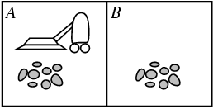
Example: Vacuum-Cleaner
States
8 states
Initial state
any state
Actions
Left, Right, and Suck
Transition model
complete state space, see next page
Goal test
whether both squares are clean
Path cost
each step costs 1

Slide 12
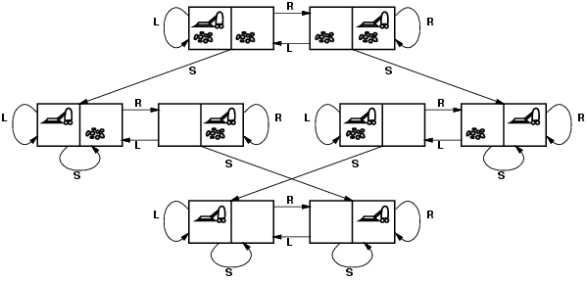
Complete State Space

Slide 13
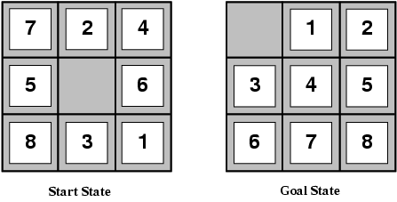
Example: 8-puzzle
NP-Complete
States:
location of each tile and the blank
Initial state: any, 9!/2
Actions:
blank moves Left, Right, Up or Down
Transition model:
Given a state and action, returns the resulting state
Goal test: Goal configuration
Path cost: Each step costs 1

Slide 14
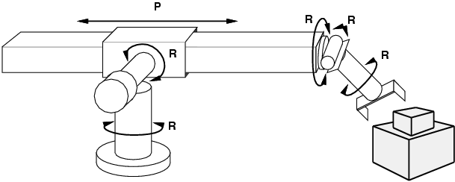
Example: Robotic Assembly
States
real-valued coordinates of robot joint angles; parts of the object to be assembled
Actions
continuous motions of robot joints
Transition model
States of robot joints after each action
Goal test
complete assembly
Path cost: time to execute

Slide 15

Missionaries & Cannibals
3 missionaries and 3 cannibals need to cross a river
1 boat that can carry 1 or 2 people
Find a way to get everyone to the other side, without ever leaving the group of missionaries in one place outnumbered by cannibals in that place
Check on this link:
http://www.learn4good.com/games/puzzle/boat.htm

Slide 16
Problem Formulation
States:
<m, c, b> representing the # of missionaries and the # of cannibals, and the position of the boat
Initial state:
<3, 3, 1>
Actions:
take 1 missionary, 1 cannibal, 2 missionaries, 2 cannibals, or 1 missionary and 1 cannibal across the river
Transition model:
state after an action
Goal test:
<0, 0, 0>
Path cost:
number of crossing

Slide 17
Real-World Problems
Touring problem: visit every city at least once, starting and ending in Bucharest
Traveling sales problem: exactly once
Robot navigation
Internet searching: software robots

Slide 18
In-Class Exercise #3.1
Give a complete problem formulation for each of the following.
You have to color a planar map using only four colors, in such a way that no two adjacent regions have the same color.
A 3-foot-tall monkey is in a room where some bananas are suspended from the 8-foot ceiling. He would like to get the bananas. The room contains two stackable, movable, climable 3-foot-high crates.
Notes:
Define: Initial State, goal test, successor function, cost function

Slide 19
Searching for Solutions
?
?
?
?
?
?

Slide 20
Searching for Solutions
Search tree: generated by initial state and possible actions
Basic idea:
offline, simulated exploration of state space by generating successors of already-explored states (expanding states)
the choice of which state to expand is determined by search strategy

Slide 21
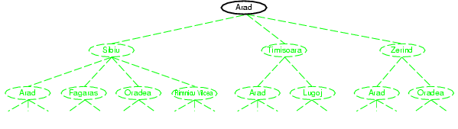
Tree Search Example

Slide 22
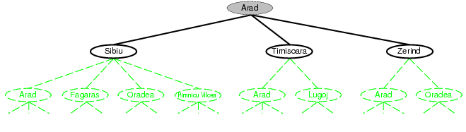
Tree Search Example

Slide 23
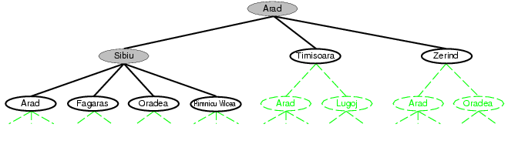
Tree Search Example

Slide 24
Terminologies
Frontier: set of all leaf nodes available for expansion at any given point
Repeated state
Loopy path: Arad to Sibiu to Arad
Redundant path: more than one way to get from one state to another
Sometimes, redundant paths are unavoidable
Sliding-block puzzle

Slide 25
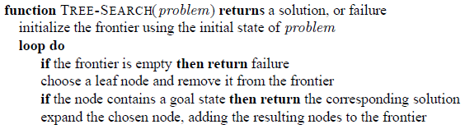
General Tree Search Algorithm

Slide 26
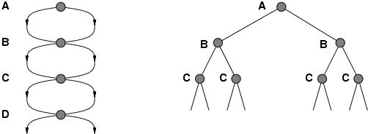
Avoiding Repeated States
Failure to detect repeated states can turn a linear problem into an exponential one!
Algorithms that forget their history are doomed to repeat it
state space size: d + 1 → search tree leaves: 2^{d}

Slide 27
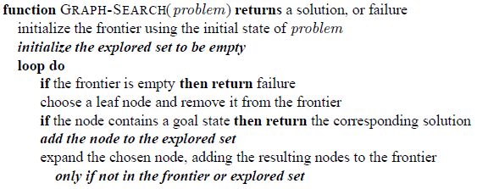
General Graph Search Algorithm
We augment Tree-Search with an explored set, which remembers every expanded node

Slide 28
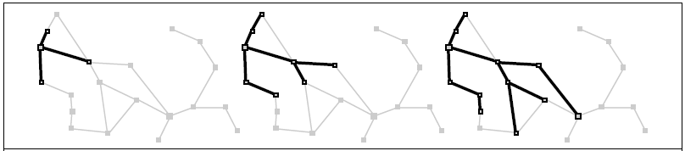
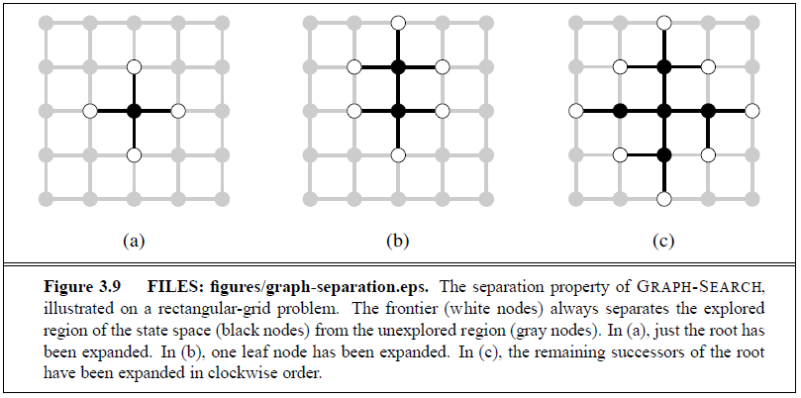
Graph Search Examples

Slide 29
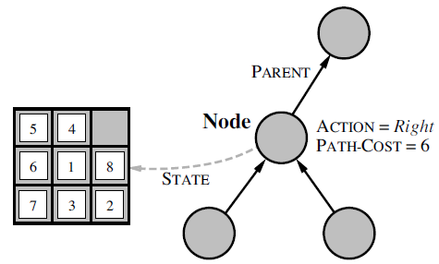
Implementation: States vs. Nodes
A state is a representation of a physical configuration
A node is a data structure constituting part of a search tree includes state, parent node, action, path cost g(n), depth
A solution path can be easily extracted

Slide 30
CHILD-NODE Function
The CHILD-NODE function takes a parent node and an action and returns the resulting child node
function CHILD-NODE(problem, parent, action) returns a node
return a node with
STATE = problem.RESULT(parent.STATE, action)
PARENT = parent
ACTION = action
PATH-COST = parent.PATH-COST +
problem.STEP-COST(parent.STATE, action)

Slide 31
Frontier and Explored Set
Goal of frontier: the next node to expand can be easily located in the frontier
Possible data structures?
Goal of explored set: efficient checking for repeated states
Possible data structures?

Slide 32
Search Strategies
A search strategy is defined by picking the order of node expansion
Strategies are evaluated along the following dimensions:
completeness: does it always find a solution if one exists?
optimality: does it always find a least-cost solution?
time complexity: number of nodes generated
space complexity: maximum number of nodes in memory
Time and space complexity are measured in terms of
b: maximum branching factor of the search tree
d: depth of the least-cost solution
m: maximum depth of the state space (may be ∞)
Search cost (time), total cost (time+space)

Slide 33
Uninformed Search Strategies
Uninformed search (blind search) strategies use only the information available in the problem definition
Strategies that know whether one non-goal state is better than another are called informed search or heuristic search
General uninformed search strategies:
Breadth-first search
Uniform-cost search
Depth-first search
Depth-limited search
Iterative deepening search

Slide 34
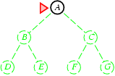
Breadth-First Search
Expand shallowest unexpanded node
Implementation:
Frontier is a FIFO queue, i.e., new successors go at end

Slide 35
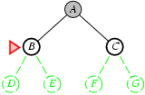
Breadth-First Search
Expand shallowest unexpanded node
Implementation:
Frontier is a FIFO queue, i.e., new successors go at end

Slide 36
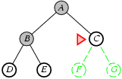
Breadth-First Search
Expand shallowest unexpanded node
Implementation:
Frontier is a FIFO queue, i.e., new successors go at end

Slide 37
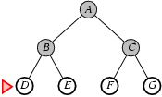
Breadth-First Search
Expand shallowest unexpanded node
Implementation:
Frontier is a FIFO queue, i.e., new successors go at end

Slide 38
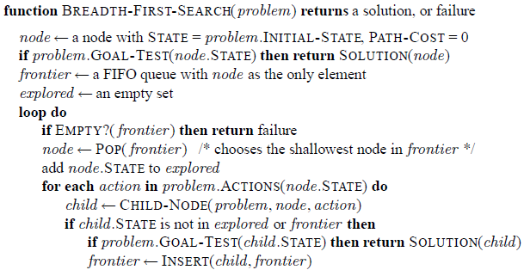
BFS on a Graph

Slide 39
Analysis of Breadth-First Search
Complete?
Yes (if b is finite), the shallowest solution is returned
Time?
b+b²+b³+… +b^{d} = O(b^{d})
Space?
O (b^{d}) (keeps every node in memory)
Optimal?
Yes if step costs are all identical or path cost is a nondecreasing function of the depth of the node
Space is the bigger problem (more than time)
Time requirement is still a major factor

Slide 40
How Bad is BFS?
With b = 10; 1 million nodes/sec; 1k bytes/node
It takes 13 days for the solution to a problem with search depth 12, nodes 10¹²
350 years at depth 16
Memory is more of a problem than time
Requires 103G when d = 8
Exponential-complexity search problems cannot be solved by uninformed methods for any but the smallest instances

Slide 41
Uniform-Cost Search
Expand least-cost unexpanded node
Implementation:
Frontier = priority queue ordered by path cost g(n)
breadth-first = uniform-cost search when?

Slide 42
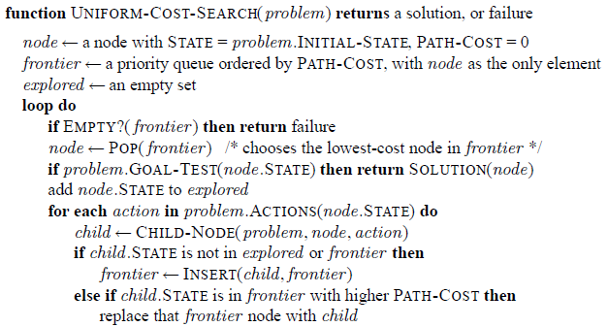
Uniform-Cost Search
Example, shown on board, from Sibiu to Bucharest

Slide 43
Analysis
Complete?
Yes, if step cost ≥ ε
Time?
O (b ^{ceiling(C*/ ε)}) where C * is the cost of the optimal solution
# of nodes with g ≤ cost of optimal solution
Space?
O (b ^{ceiling(C*/ ε)})
# of nodes with g ≤ cost of optimal solution
Optimal?
Yes – nodes expanded in increasing order of g(n)

Slide 44
Uniform-Cost Search is Optimal
Uniform-cost search expands nodes in order of their optimal path cost
Hence, the first goal node selected for expansion must be the optimal solution

Slide 45
In-Class Exercise #3.2
Use uniform-cost search implemented with the graph search algorithm to find a route from Arad to Bucharest on the Romania map.

Slide 46
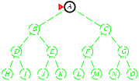
Depth-First Search
Expand deepest unexpanded node
Implementation:
frontier = LIFO queue, i.e., put successors at front
Or a recursive function

Slide 47
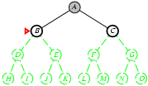
Depth-First Search
Expand deepest unexpanded node
Implementation:
frontier = LIFO queue, i.e., put successors at front
Or a recursive function

Slide 48
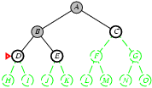
Depth-First Search
Expand deepest unexpanded node
Implementation:
frontier = LIFO queue, i.e., put successors at front
Or a recursive function

Slide 49
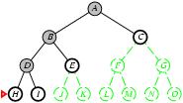
Depth-First Search
Expand deepest unexpanded node
Implementation:
frontier = LIFO queue, i.e., put successors at front
Or a recursive function

Slide 50
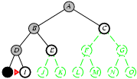
Depth-First Search
Expand deepest unexpanded node
Implementation:
frontier = LIFO queue, i.e., put successors at front
Or a recursive function

Slide 51
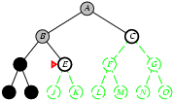
Depth-First Search
Expand deepest unexpanded node
Implementation:
frontier = LIFO queue, i.e., put successors at front
Or a recursive function

Slide 52
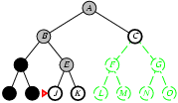
Depth-First Search
Expand deepest unexpanded node
Implementation:
frontier = LIFO queue, i.e., put successors at front
Or a recursive function

Slide 53
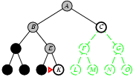
Depth-First Search
Expand deepest unexpanded node
Implementation:
frontier = LIFO queue, i.e., put successors at front
Or a recursive function

Slide 54
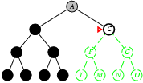
Depth-First Search
Expand deepest unexpanded node
Implementation:
frontier = LIFO queue, i.e., put successors at front
Or a recursive function

Slide 55
Properties of DFS
Properties of DFS depend strongly on whether the graph-search or tree-search version is used

Slide 56
Analysis of DFS + Tree Search
Complete?
No: fails in infinite-depth spaces, or spaces with loops
Modify to avoid repeated states along path
→ complete in finite spaces
Time?
O (b^{m}): terrible if m is much larger than d
but if solutions are dense, may be much faster than breadth-first
Space?
O (bm), i.e., linear space!
Optimal?
No

Slide 57
Analysis of DFS + Graph Search
Complete?
No: also fails in infinite-depth spaces
Yes: for finite state spaces
Time?
O (b^{m}): terrible if m is much larger than d
but if solutions are dense, may be much faster than breadth-first
Space?
Not linear any more, because of explored set
Optimal?
No

Slide 58
Backtracking Search
Backtracking search is a variant of DFS
Only one successor is generated at a time rather than all successors
Each partially expanded node remembers which successor to generate next
Memory requirement: O(m) vs. O(bm)

Slide 59
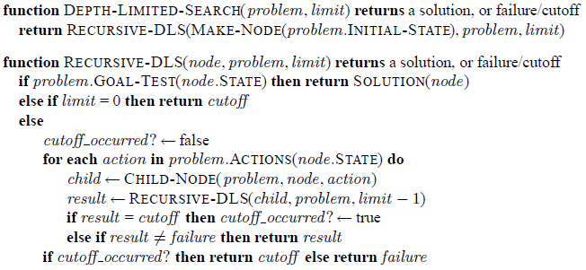
Depth-Limited Search
Is the same as depth-first search with depth limit l, nodes at depth l are treated as if they have no successors
Complete? Time? Space? Optimal?

Slide 60
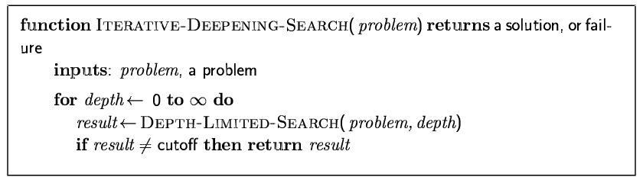
Iterative Deepening DF-Search
Gradually increase the depth limit until a goal is found
Combines the benefits of depth-first and breadth-first search

Slide 61
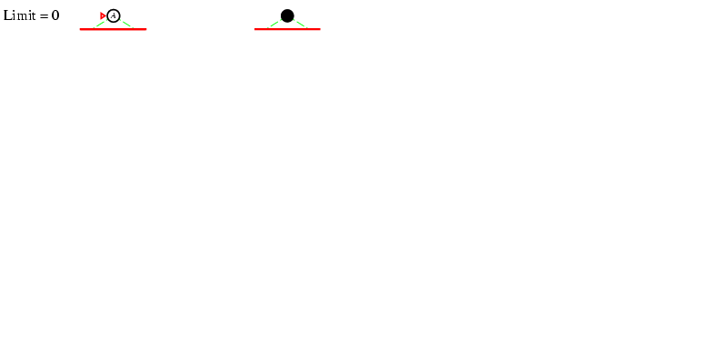
Depth Limit = 0

Slide 62
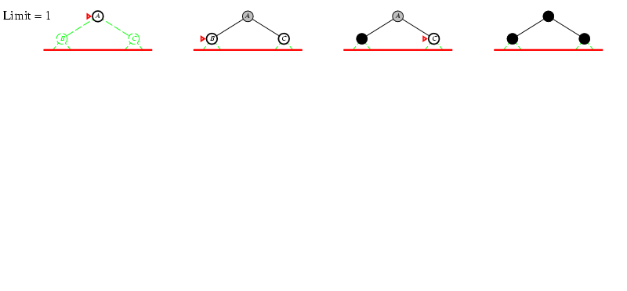
Depth Limit = 1

Slide 63
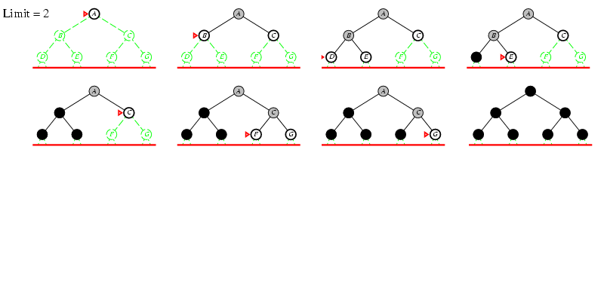
Depth Limit = 2

Slide 64
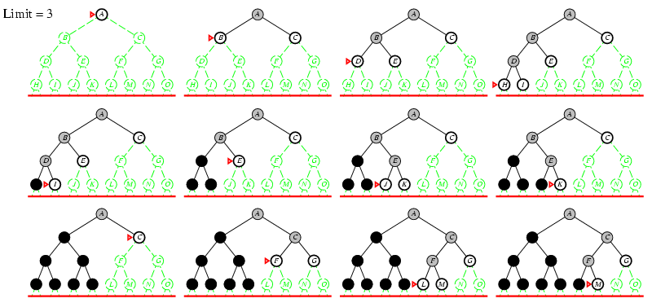
Depth Limit = 3

Slide 65
Analysis of Iterative Deepening Search
Number of nodes generated in a depth-limited search to depth d with branching factor b:
N_{DLS} = b⁰ + b¹ + b² + … + b ^{d-2} + b ^{d-1} + b ^{d}
Number of nodes generated in an iterative deepening search to depth d with branching factor b:
N_{IDS} = (d+1)b⁰ + d b¹ + (d-1)b² + … + 3b^{d-2} +2b^{d-1} + b^{d}
For b = 10, d = 5,
N_{DLS} = 1 + 10 + 100 + 1,000 + 10,000 + 100,000 = 111,111
N_{IDS} = 6 + 50 + 400 + 3,000 + 20,000 + 100,000 = 123,456
Overhead = (123,456 - 111,111)/111,111 = 11%
IDS is the preferred uninformed search method when search space is large and depth of solution is unknown

Slide 66
Analysis, Continue
Complete?
Yes
Time?
(d+1)b⁰ + d b¹ + (d-1)b² + … + b^{d} = O(b^{d})
Space?
O(bd) (tree search version)
Optimal?
Yes, if step costs are identical or path cost is a nondecreasing function of the depth of the node

Slide 67
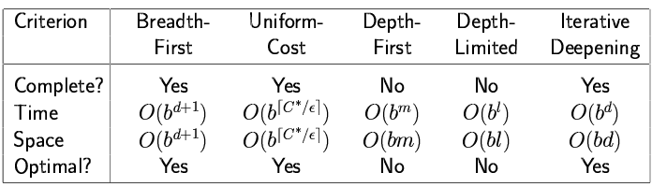
Summary of Uninformed Tree Search Strategies
Complete and optimal under certain conditions
Discussion on bidirectional search

Slide 68
Analysis of Graph Search
Much more efficient than Tree-Search
Time and space are proportional to the size of the state space
Optimality:
uniform-cost search or breadth-first search with identical step costs are still optimal even if it returns the first path found
iterative-deepening, identical step cost or non-decreasing function of depth of a node
Tradeoff: depth-first or iterative deepening are not linear anymore

Slide 69
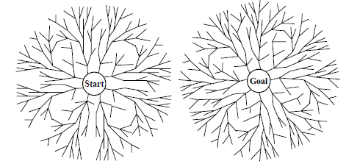
Bidirectional Search
Runs two simultaneous searches
Forward from initial state
Backward from goal state

Slide 70
Summary
We have covered methods for selecting actions in environments that are deterministic, observable, static, and completely known
Problem formulation requires abstraction
Uninformed search strategies

Slide 71
In-Class Exercise #3.3
Define the following terms:
State, state space, search tree
Does a finite state space always lead to a finite search tree?
How about a finite state space that is a tree or a finite directed acyclic graph?

Slide 72
In-Class Exercise #3.4
Consider a state space where the start state is number 1 and the successor function for state n returns two states, numbers 2n and 2n+1
Draw the portion of the state space from 1 to 15
Suppose the goal state is 11. List the order in which nodes will be visited for BFS, DLS with limit 3, and IDS.
How well would bidirectional search work on this problem?

Slide 73
In-Class Exercise #3.5
Is uniform-cost search optimal when it’s implemented with the graph-search algorithm? Why?
Is BFS with constant step costs optimal when it’s implemented with the graph-search algorithm? Why?

Slide 74
In-Class Exercise #3.6
Show a state space with varying step costs in which Graph-Search using iterative deepening finds a suboptimal solution.

Slide 75
In-Class Exercise #3.7
Describe a state space in which iterative deepening search performs much worse than depth-first search (for example, O(n²) vs. O(n)).

